Slide 1

Tennessee Early Intervention System (TEIS)
Analysis Regarding the Departure and/or Returning of Eligible Children into the Program
Presented by Nashville Software School DDA6

Slide 2

Objectives and MVP
Taking the data provided by the TEIS, analyzing, and recalculating the actual days of service.
Due to some children re-entering and/or leaving the program multiple times, actual service days were incorrect.

Slide 3
New Totals After Analysis
Difference of 15
Difference of 75
Difference of 75

Slide 4
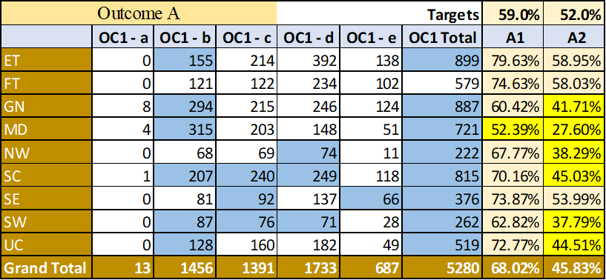
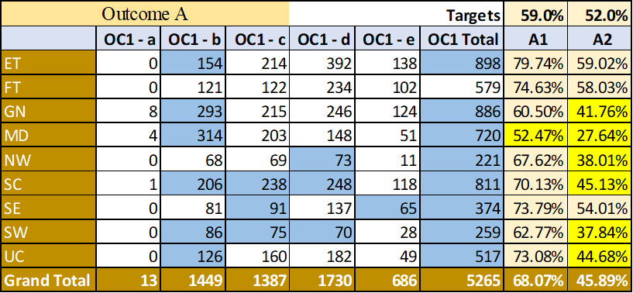
Outcome A
Original
Post-Analysis
= Changes Between Original and Post-Analysis
= Did Not Meet Outcome Targets

Slide 5
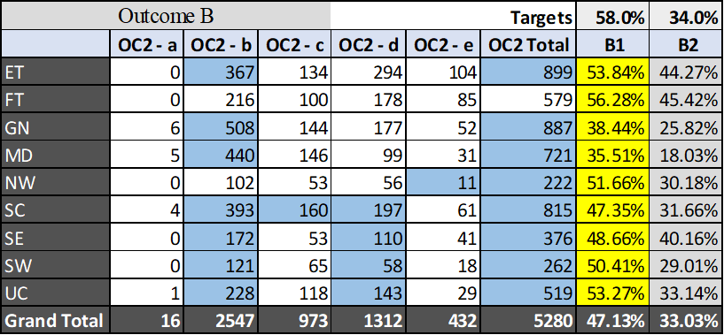

Outcome B
Original
Post-Analysis
= Changes Between Original and Post-Analysis
= Did Not Meet Outcome Targets

Slide 6
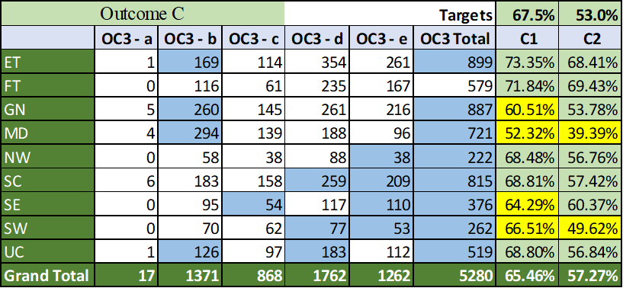
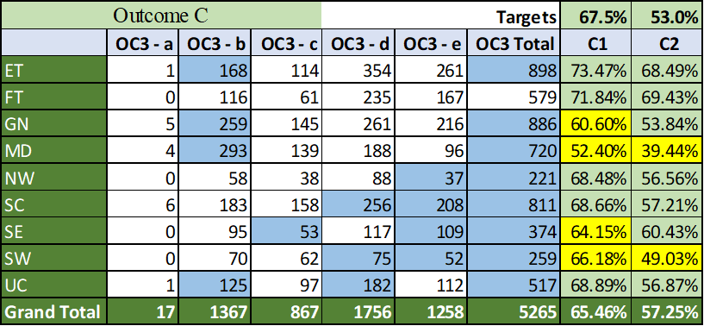
Outcome C
Original
Post-Analysis
= Changes Between Original and Post-Analysis
= Did Not Meet Outcome Targets

Slide 7
Children Leaving the Program
Of the 8,441 children that
entered the program,
4,199 of children exited due to
Age Ineligibility.

Slide 8
Why Did Children Exit Early From TEIS and Later Return?

Slide 10
Findings
Total Amount of Excess Days Found: 136,658
The most reported reasons for eligible children not finishing the TEIS program are:
Parents either declining support or withdrawing the child from support.
Being unable to contact the parents regarding the program.
Most children left the program due to aging out.

Slide 11

Solutions
Enhancing the program/parent relationship to mitigate the risk of parents withdrawing or being nonresponsive.
Ensuring parents are aware of all available resources.
Expanding the program past the child’s third birthday.

